Slide 1
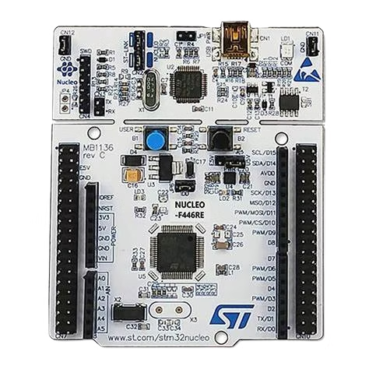
Data Logger using FreeRTOS on STM32
Viren Sharma-21UEC143 Kartik Khandelwal-21UEC071
Faculty mentor- Dr. Deepak Nair
1

Slide 2

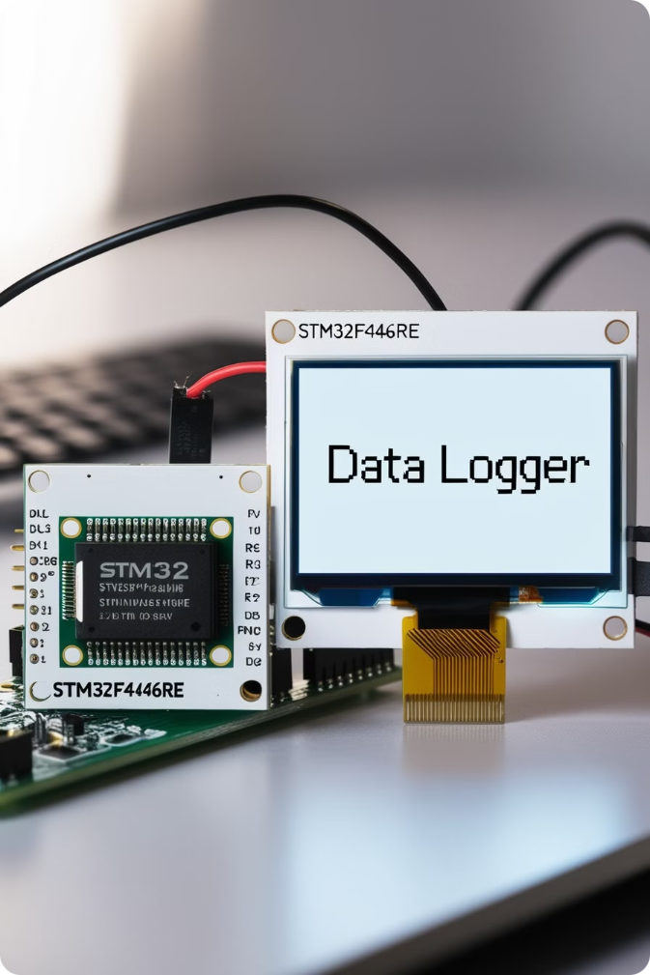
Project Overview and Design Goals
1
Goal
Build a real-time, accurate data logging system with low power consumption.
2
Design Goals
Efficient data collection from multiple sensors (RCWL0516, MQ135, RTC Module).
Real-time data display on an OLED screen.
Ensure synchronized access to shared resources using RTOS mechanisms (mutexes and semaphores).
Reliable data storage on an SD card with
timestamped entries.
Modular system architecture to facilitate debugging and future expansions.
2

Slide 3
Components
RCWL-0516
RTC Module
OLED SSD1306
A proximity sensor to detect human in the environment.
Provides accurate timekeeping, crucial for timestamping data.
Provides a clear real-time display for visualization of collected data.
SD Card
MQ135
STM32F446RE
Offers non-volatile memory for long-term data storage, ensuring data persistence.
Air quality sensor for detecting gases.
Handles sensor data acquisition, data processing, and system control using RTOS.
3

Slide 4
System Architecture
OLED Display
PC
CPU Core Temperature
DMA
I2C
UART
Display Task
ADC
Inbuilt-Real-Time Clock
Mutex
RCWL-0516 Motion Sensor
STM32
Digital
O/P
Mutex
ADC
Interrupt
Programmable
Switch
MQ135 Sensor
Logging Task
Binary Semaphore
SPI
Write Data to SD Card
4

Slide 5
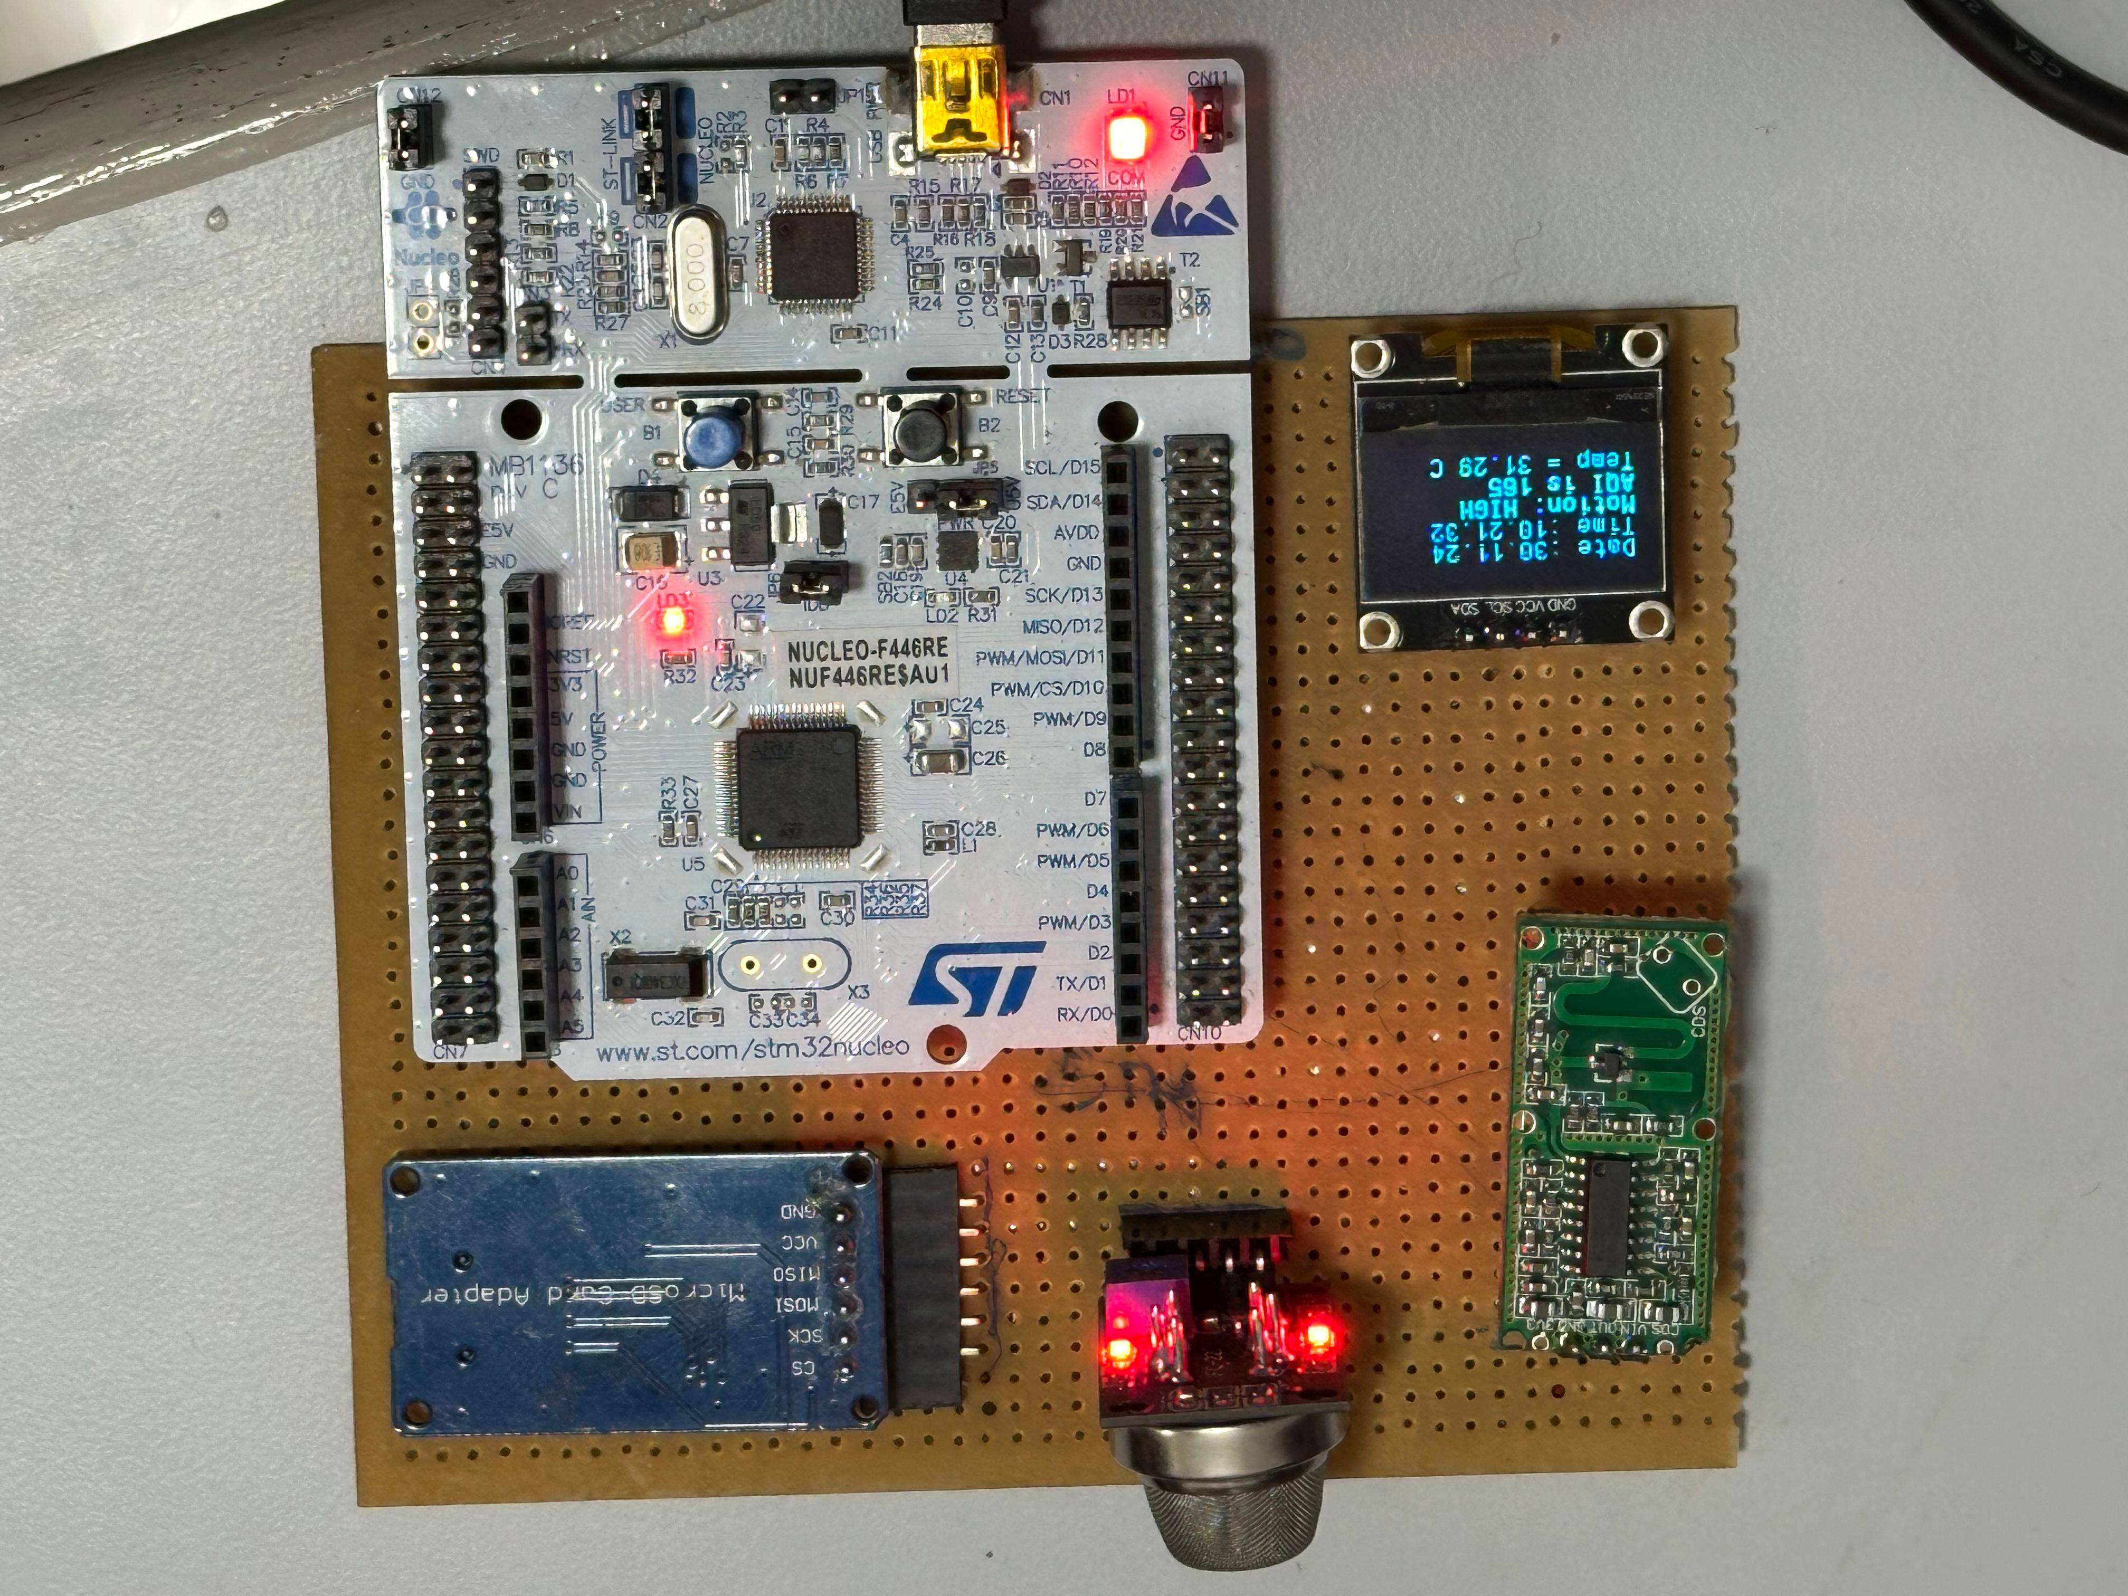
Proposed System
MQ135
SD card module
RCWL-0516
OLED
STM32 Nucleo
5

Slide 6
How we utilized Mutex and Semaphore
Mutex: Ensuring Safe Resource Access
OLED Display:
A mutex ensures only one task can write to the OLED display at a time, preventing
conflicts and data corruption.
1
SD Card:
Same mutex synchronizes access to the SD card, ensuring that only one task
writes data at a time to avoid collisions.
Give and Take mechanism of mutex ensures that a resource such as the SD card
and OLED is not simultaneously accessed by multiple tasks.
Binary Semaphore
2
Switch Task:
Programmable switch task utilizes semaphore functionality to allow
interrupt functionality with FreeRTOS architecture. The semaphore is
preferred when utilizing the ISR functionality.
6

Slide 7
Issues Encountered
Hardfault Issue: Our program entered hardfault due to memory overflow
in the task which upon debugging was altered. Stack size details were analyzed
using the CubeMX FreeRTOS task list, which was configured to monitor stack
utilization and identify potential overflows or memory mismanagement.
Priority of OLED task: The comprehensive breakpoint debugging approach
allowed in better understanding the data corruption on screen due to
simultaneous sending of data onto the OLED via various tasks. To avoid such
corruption mutexes were used.
7

Slide 8
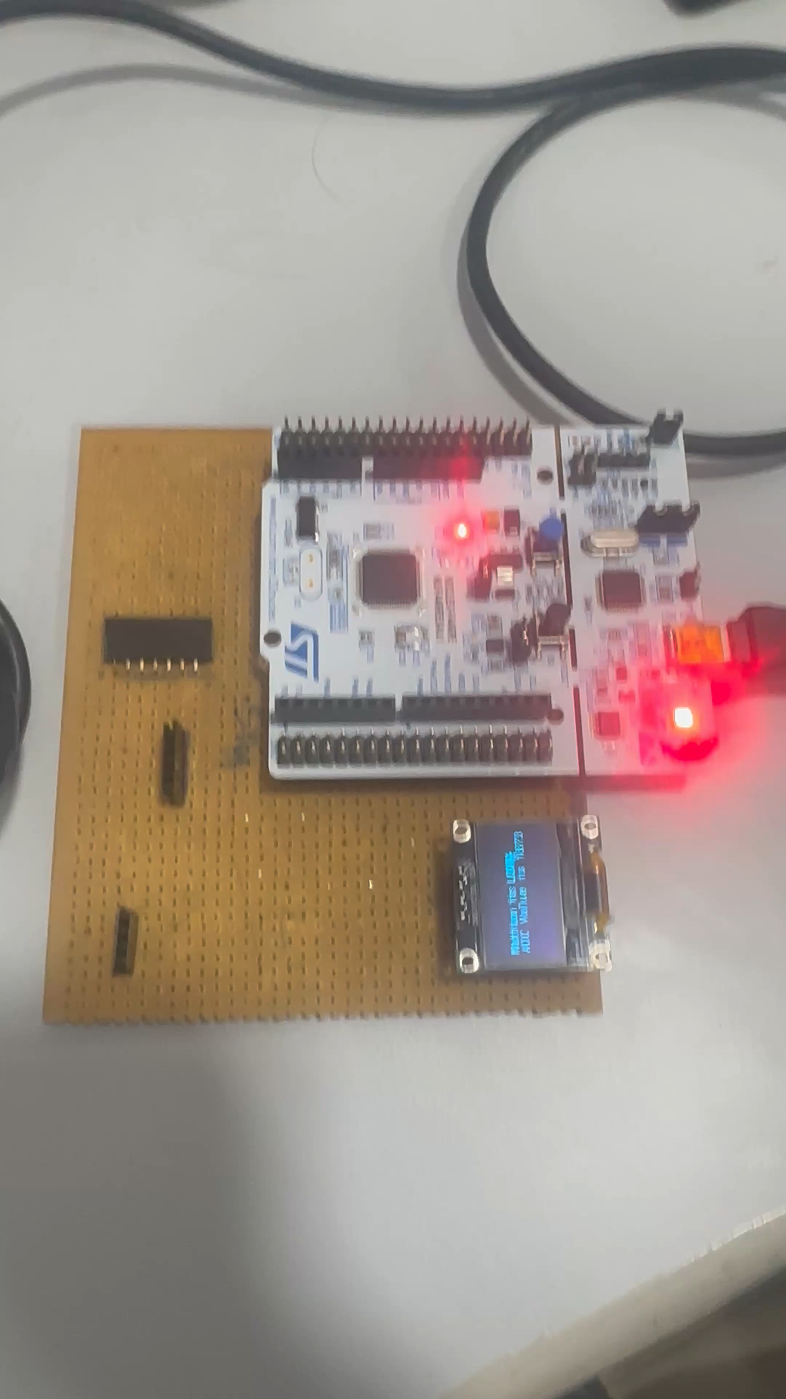
8

Slide 9
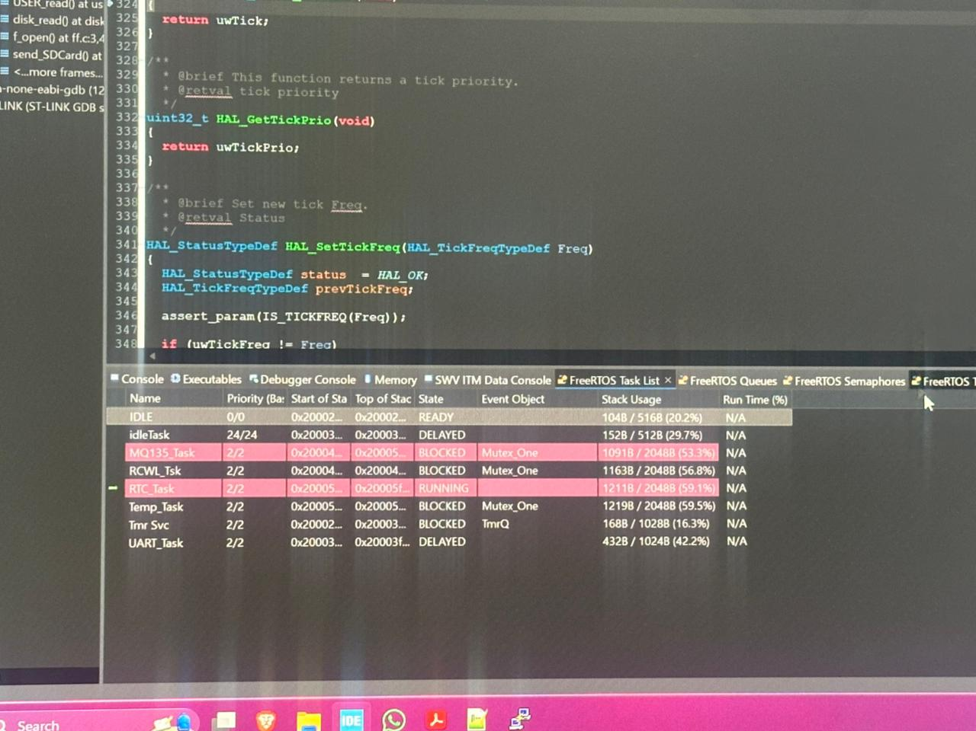
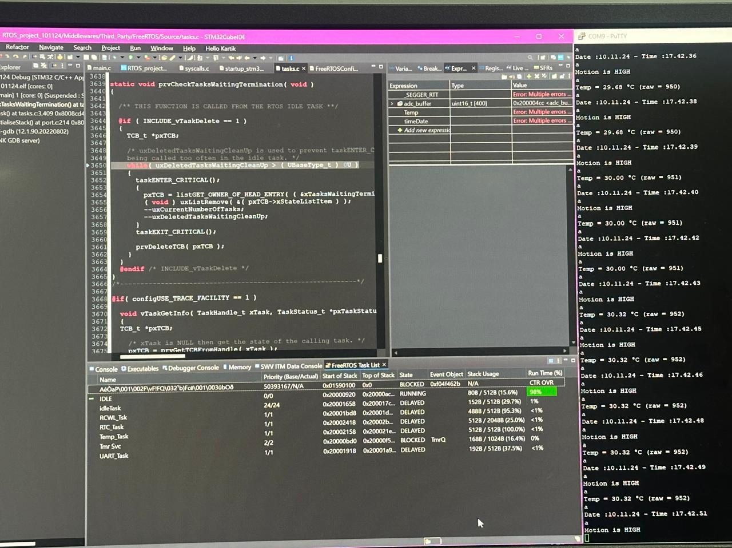
FreeRTOS Task list
9

Slide 10
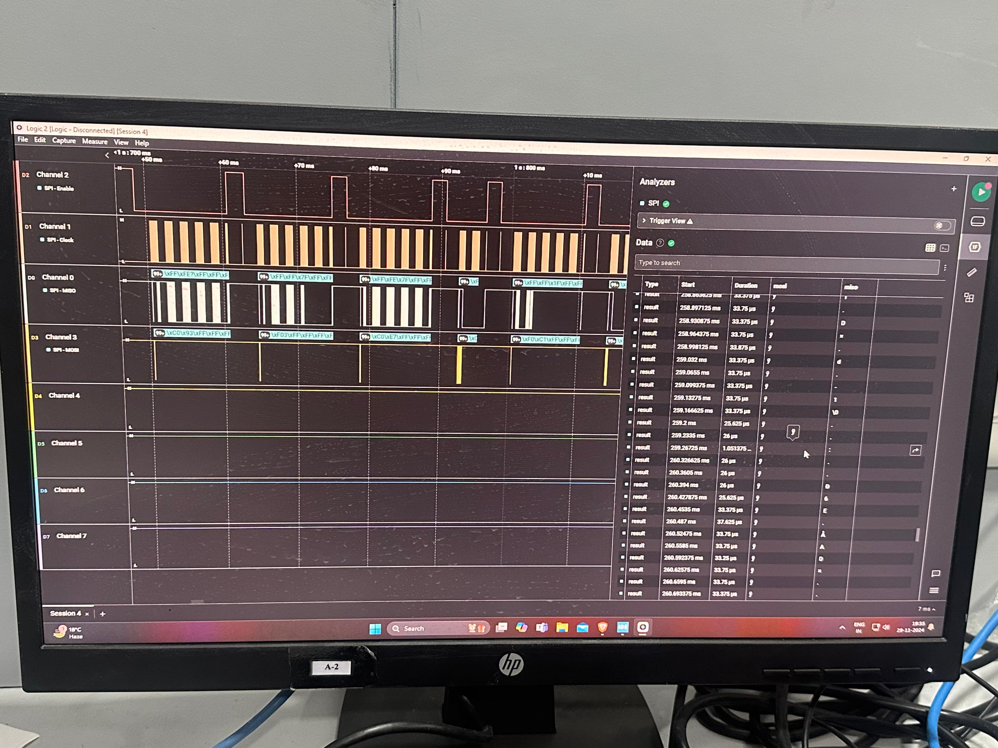
SPI
10

Slide 11
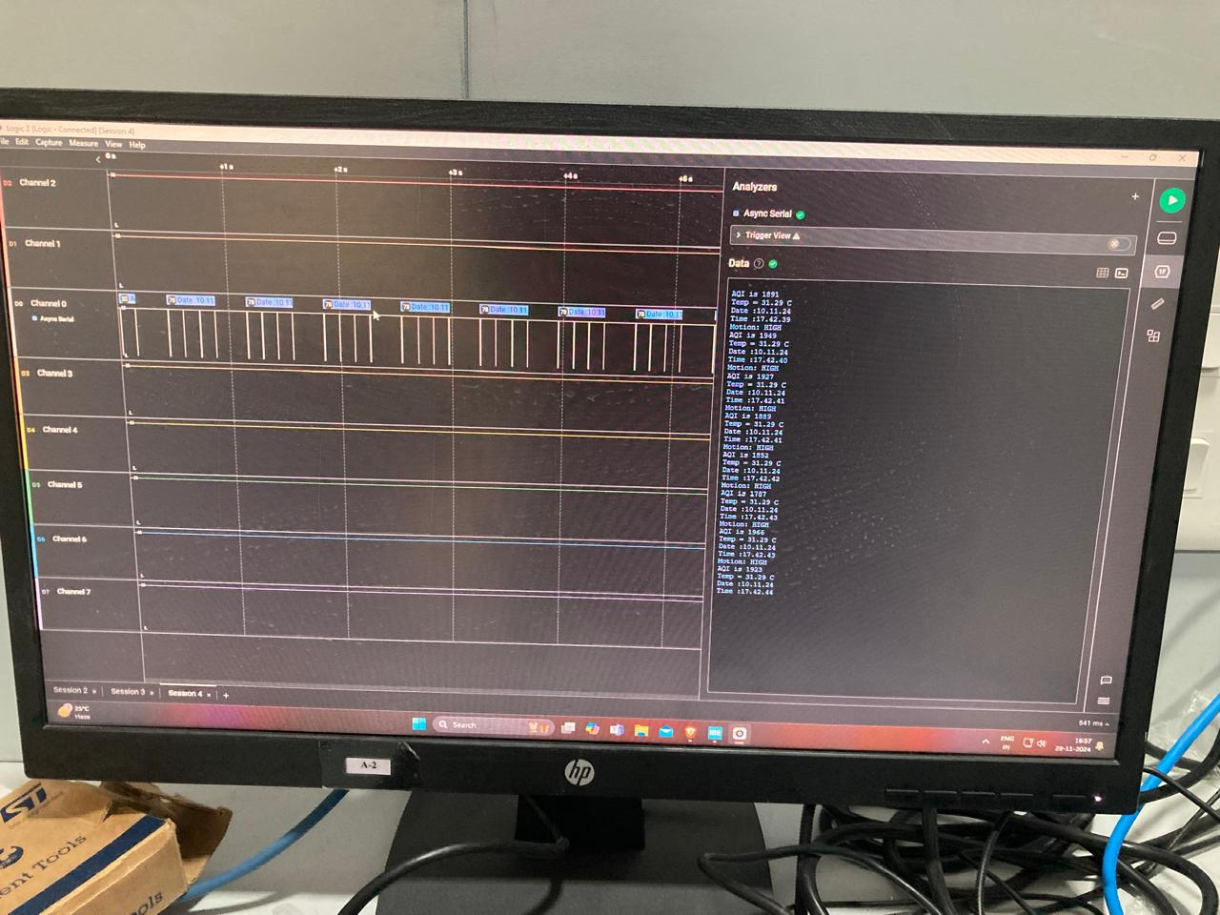
UART
11

Slide 12
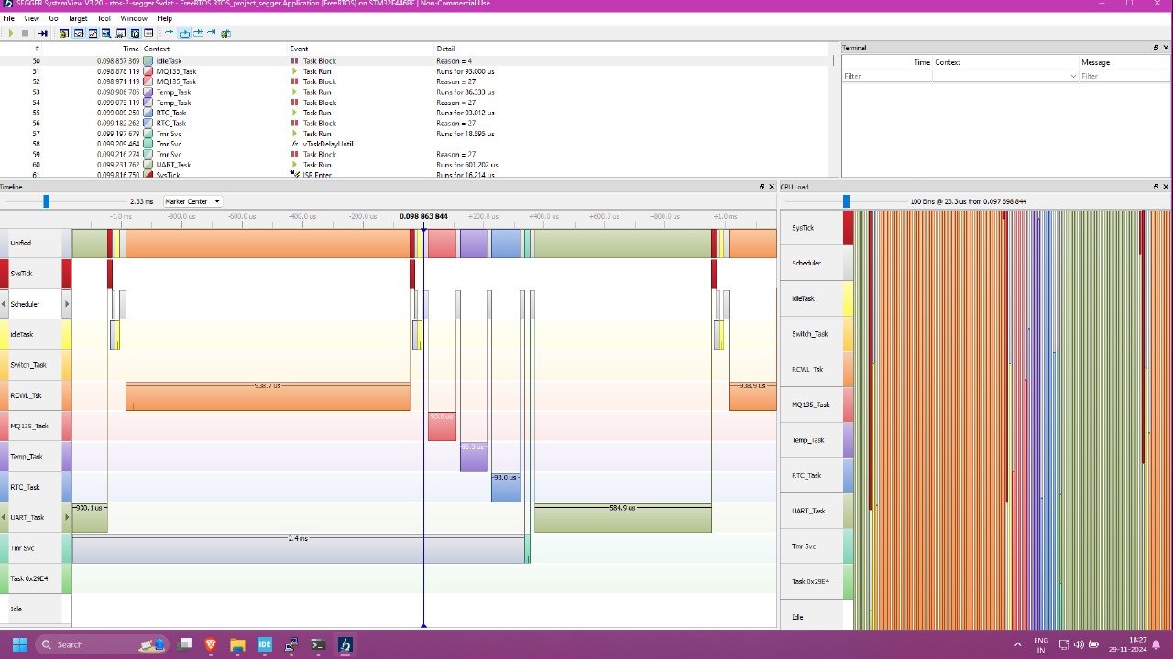
Segger
12

Slide 13
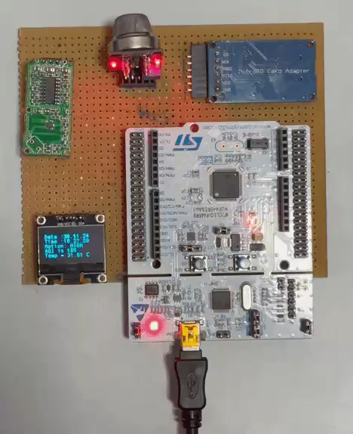
Working
13

Slide 14
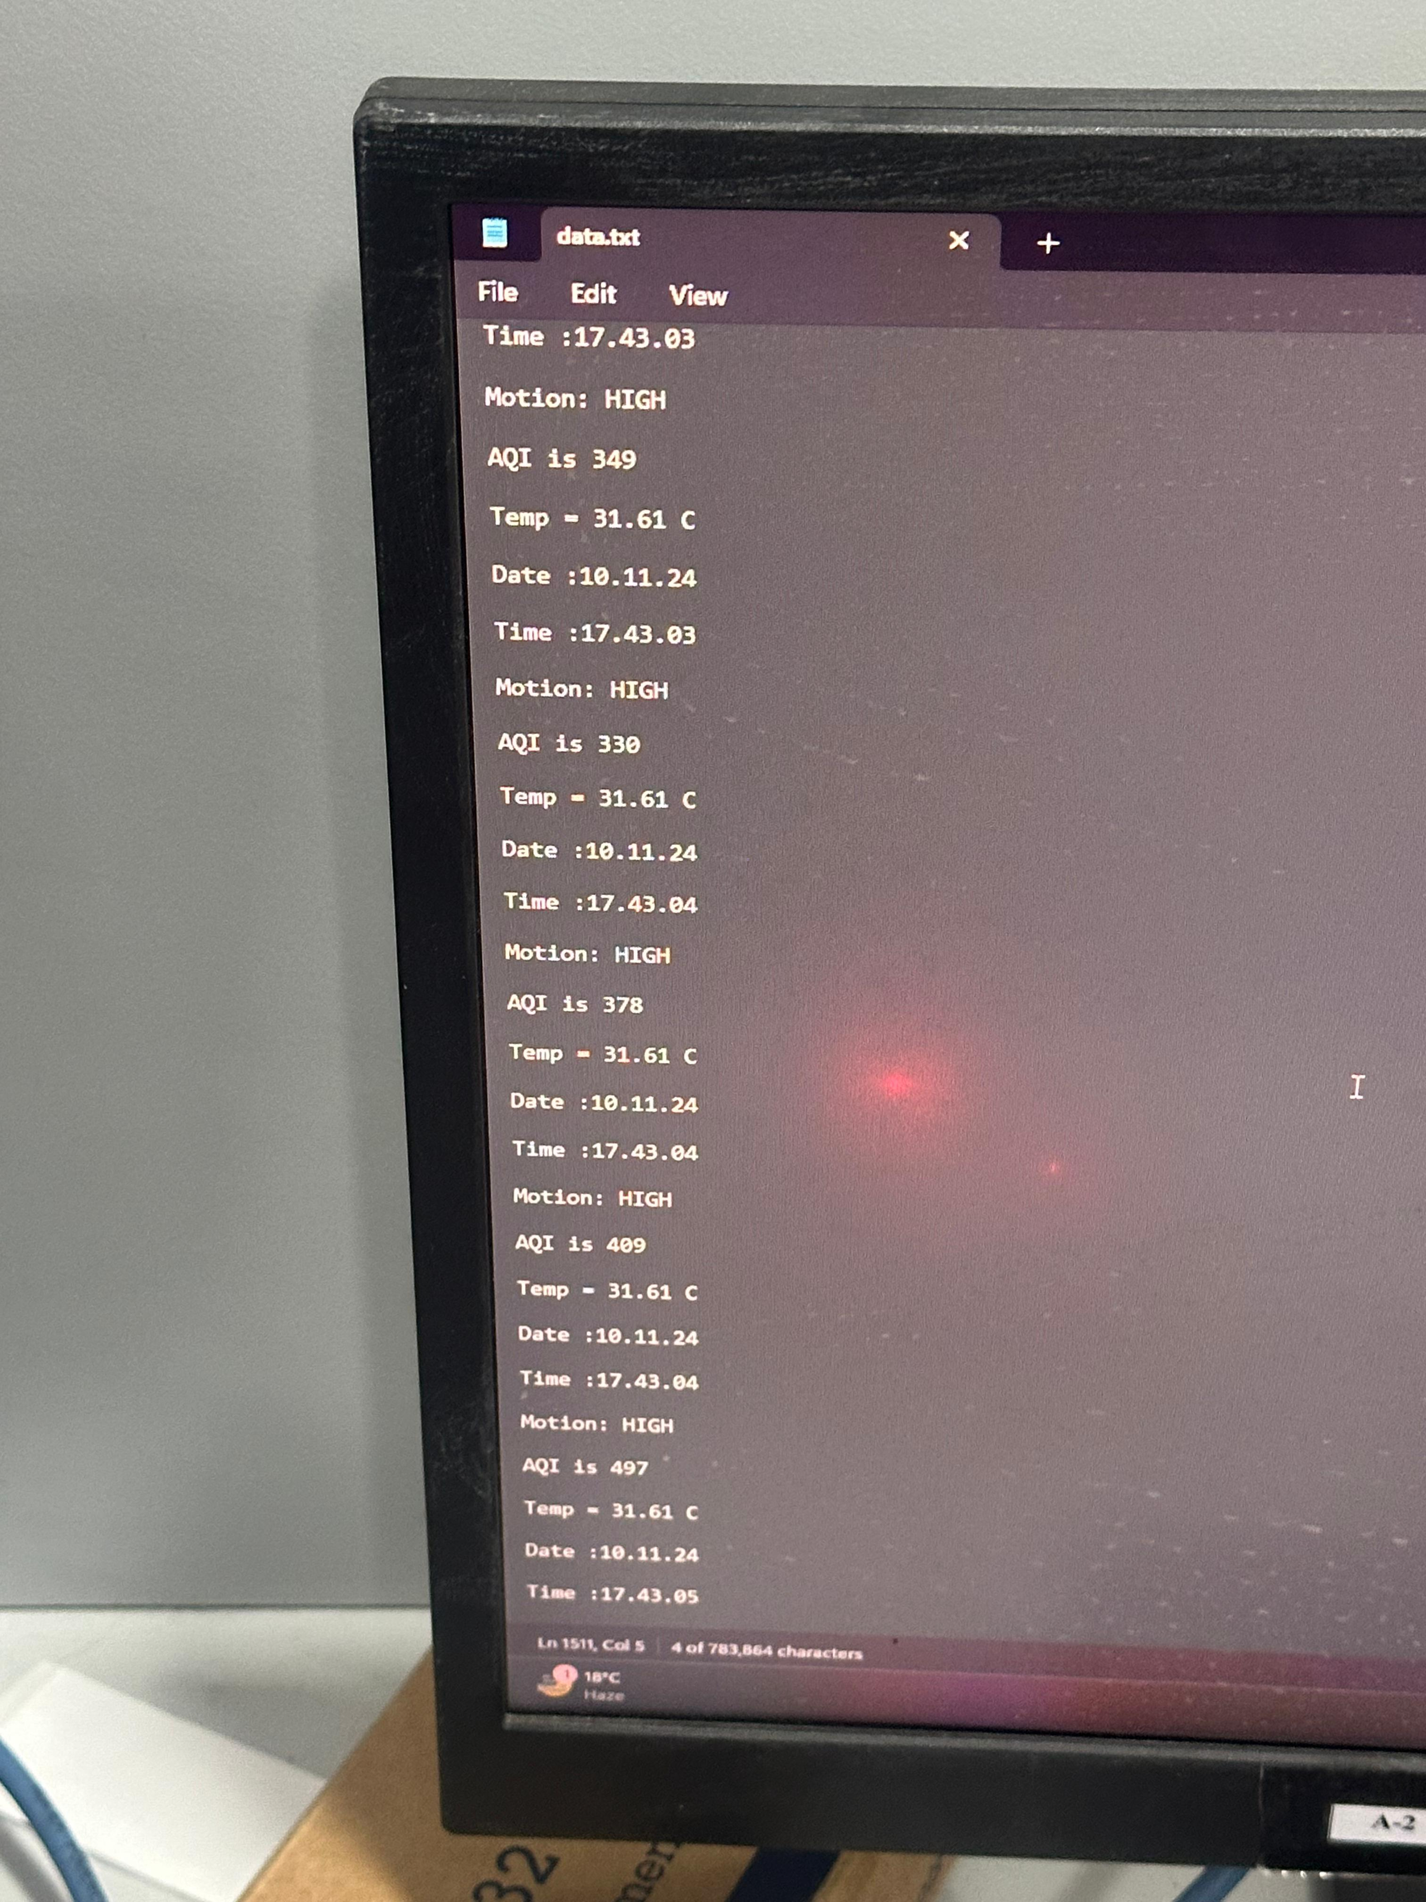
SD Card Data
14

Slide 15
T I M E L I N E
Basic Code and Testing
Testing and Prototyping
Final design coding and testing, Final Submission
1-15 September
1-15 October
31 October-15 November
16-30 September
16-30 October
16-30 November
Basic Code
Basic Code, Testing and Debugging
Testing, debugging, prototyping, final design and report writing
15

Slide 16
Thank You
14

